Slide 1


Where do Models go Wrong? Parameter-Space Saliency Maps for Explainability
Md Mahfuzur Rahman
Postdoctoral Research Associate
TReNDS Center
Georgia State University
Notes:
Deep learning has been very popular in recent times almost in all areas of science and engineering. But the interpretability of these DL models has been a vital issue because the internal behavior of these models is still unknown.

Slide 2
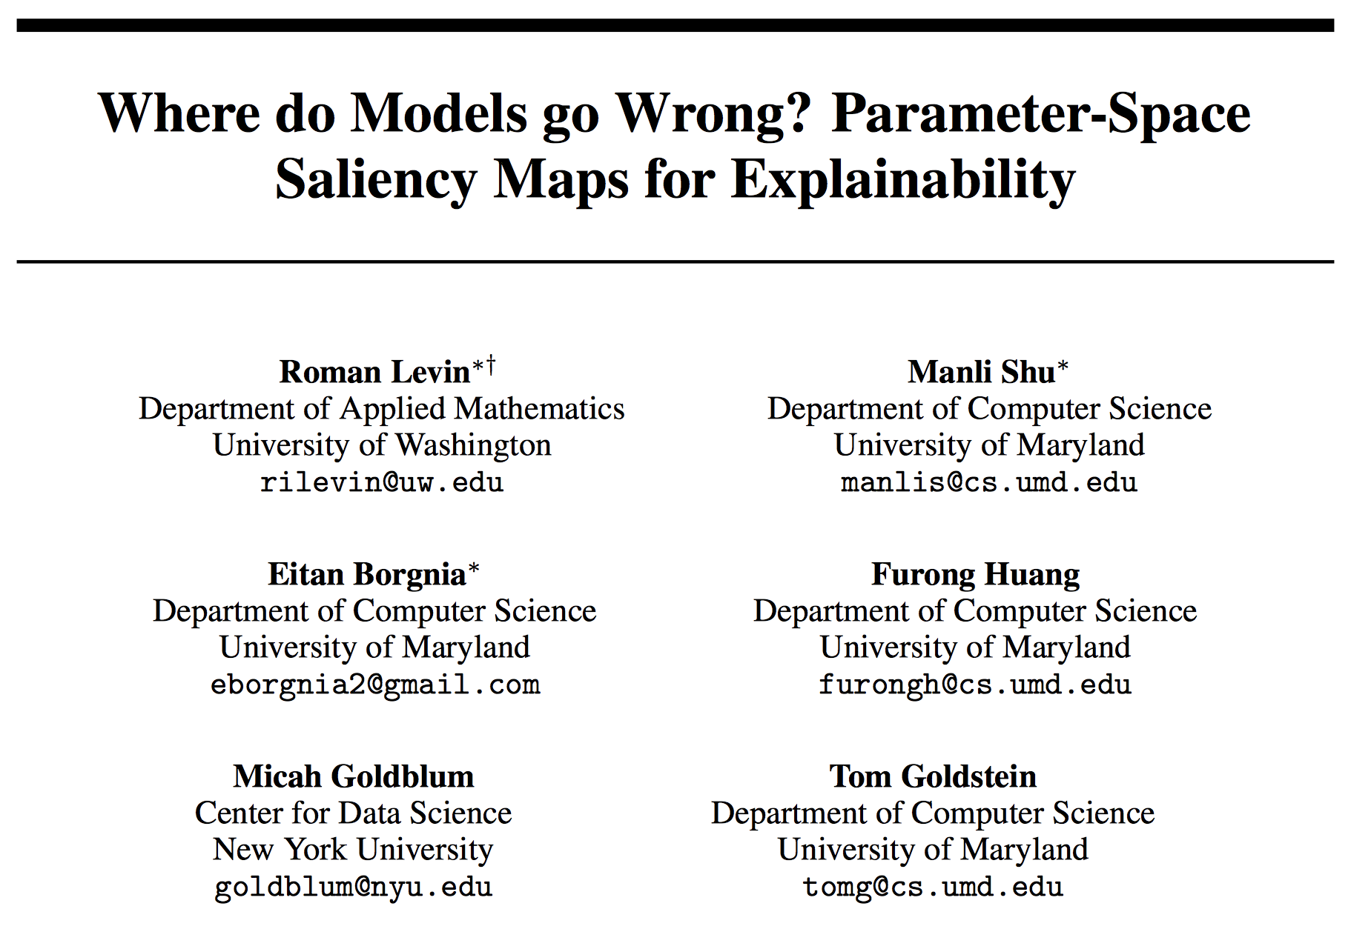
Paper Information
Venue: NeurIPS 2022
Best paper award
paper link

Slide 3
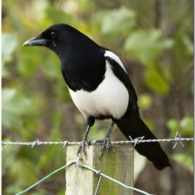
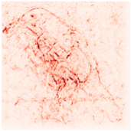
Post hoc explanations – a brief introduction
Input:
Model:
Class-specific logit:
Input
Explanation:
Explanation
E
Model
(usually Black-box)
Explanation

Slide 4
Introduction
This offers a paradigm shift for model explainability
Conventional saliency maps highlight input features to which neural network predictions are highly sensitive.
This work takes a different route---it considers parameter space saliency.
Diagnosing the causes of system failures
Notes:
Diagnosis is particularly crucial for understanding the flaws and limitations of models. However, traditional saliency maps are not useful for diagnosing undesirable model behaviors as they do not necessarily identify areas (in model space) that specifically cause bad performance.

Slide 5
Highlights
Identification and analysis of the network parameters, rather than inputs, which are responsible for erroneous decisions.
Turning off these parameters improves misclassification ---for the validation¹.
fine-tuning a small number of the most salient parameters on a single sample results in error correction on other samples
samples which cause similar parameters to malfunction are semantically similar.
Shows an association between an input-space saliency and malfunctioning network components.
¹Sameek et al., Evaluating the visualization of what a deep neural network has learned
Notes:
Bullet 2: turning these parameters off improves predictions on the associated samples. A method similar to MoRF is used.
Bullet 3/4: Fine tuning on a single sample helps improving the which were misclassified for similar reasons – nearest neighbors in the saliency space.
Bullet 5: input-space saliency counterpart which reveals how image features cause specific network components to malfunction. Basically, it identifies image regions that interact with those malfunctioning parameters (erroneous filters).

Slide 6
Key Idea(s)
Different network filters are responsible for identifying different image properties
Mistakes can be understood by identifying erroneous filters/network parameters.
Use gradient information of the loss function as a measure of parameter sensitivity.

Slide 7
Parameter saliency profile
the gradients on training data for a model trained to convergence are near zero
A sample from validation or hold out set
Corresponding label
a larger gradient norm at the point indicates a greater inefficiency in the network’s classification
Notes:
S(x, y) basically measures the suboptimality of model parameters.

Slide 8
Identify filter(s) where the loss is most sensitive
Trick:
average the gradient magnitudes of parameters corresponding to each convolutional filter

Slide 9
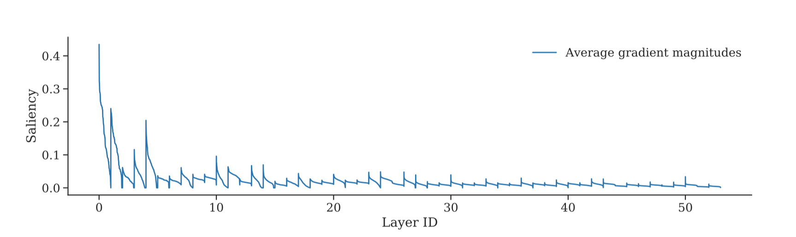
Average saliency profile
Fig:1 ResNet-50 filter-wise saliency profile (without standardization) averaged over samples
in ImageNet validation set.
Notes:
The filter saliency values in each layer are sorted in descending order, and each layer’s saliency values are concatenated.
Observe: shallower filters are more salient than deeper filters.

Slide 10
Why are shallower filters more salient?
Early filters encode low-level features, such as edges and textures, which are active across a wide spectrum of images.
Typical networks have fewer filters in shallow layers than in deep layers, making each individual filter more influential at shallower layers.
The effects of early filters cascade and accumulate as they pass through a network.

Slide 11
Standardization of saliency-profile
standardized saliency-profile for all convolutional filters in the network for sample x

Slide 12
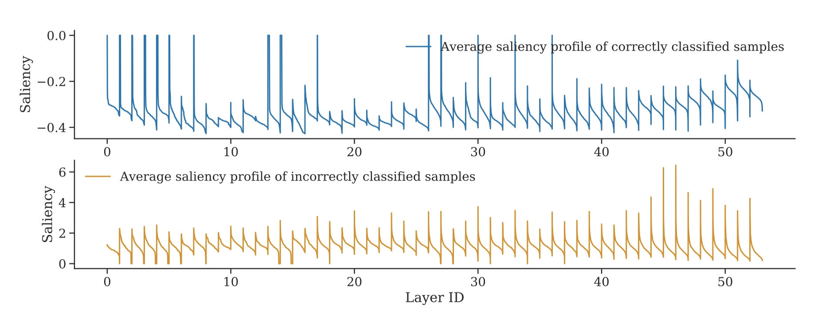
Standardization of filter-wise saliency
Fig:2 ResNet 50 standardized filter-wise saliency profiles, correctly vs incorrectly classified
samples averaged over samples in ImageNet validation set.
Notes:
saliency profiles of incorrectly classified samples exhibit, on average, greater values than those of correctly classified examples.
deeper parts of the network appear to be most salient for the incorrectly classified samples while earlier layers are often the most salient for correctly classified samples.

Slide 13
Input-Space Saliency
which input pixels are sensitive to making the salient filters more salient?
Set of salient filters we want to explore
Boosted saliency profile
Cosine distance
Notes:
Visualizing How Filters Malfunction:

Slide 14
Experiments
Dataset and models:
CIFAR 1-/ResNet-18
ImageNet/ResNet-50
Validation:
Zero out the filter weights and also the biases of the associated batch normalization layers.
Observe change in the incorrect class confidence, the change in the true class confidence, and the percentage of the samples that flip their label to the correct class.
Compare the most salient against the random and least salient features.
Notes:
This (zero out) procedure guarantees that the corresponding input feature map to the next convolutional layer is always zero.
This validation is done on each sample separately and then averaged over all samples.

Slide 15
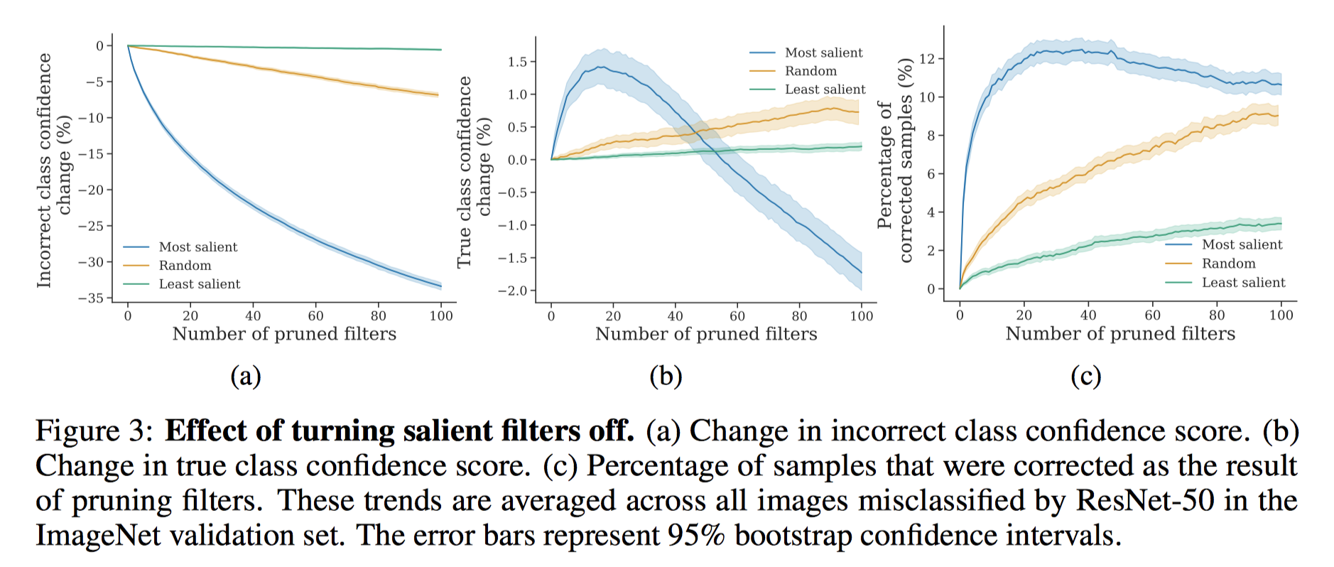
Validation
(a) Shows if top salient filters are pruned, it drops the misclassified class’s confidence.
(b) Shows if top salient filters are pruned, it changes the true class confidence for the better
(c) Pruning salient filters corrects many misclassifications.
Notes:
gradually pruning the top 100 salient filters achieves up to 30% drop in the incorrect class confidence score while pruning random filters yields only about 7% decrease. We also note that pruning the least salient filters does not produce any effect on the incorrect class confidence.
the highest true class confidence gain occurs when we prune around 20 most salient filters. Pruning enough salient filters eventually leads to a gradual decrease in the true class confidence.
pruning around 30 most salient filters results in the best correct classification rate of 12%. (my comments: For other cases, the trends have similarity. So, it means lots of unnecessary params are already there and doing the worse rather than the better)

Slide 16
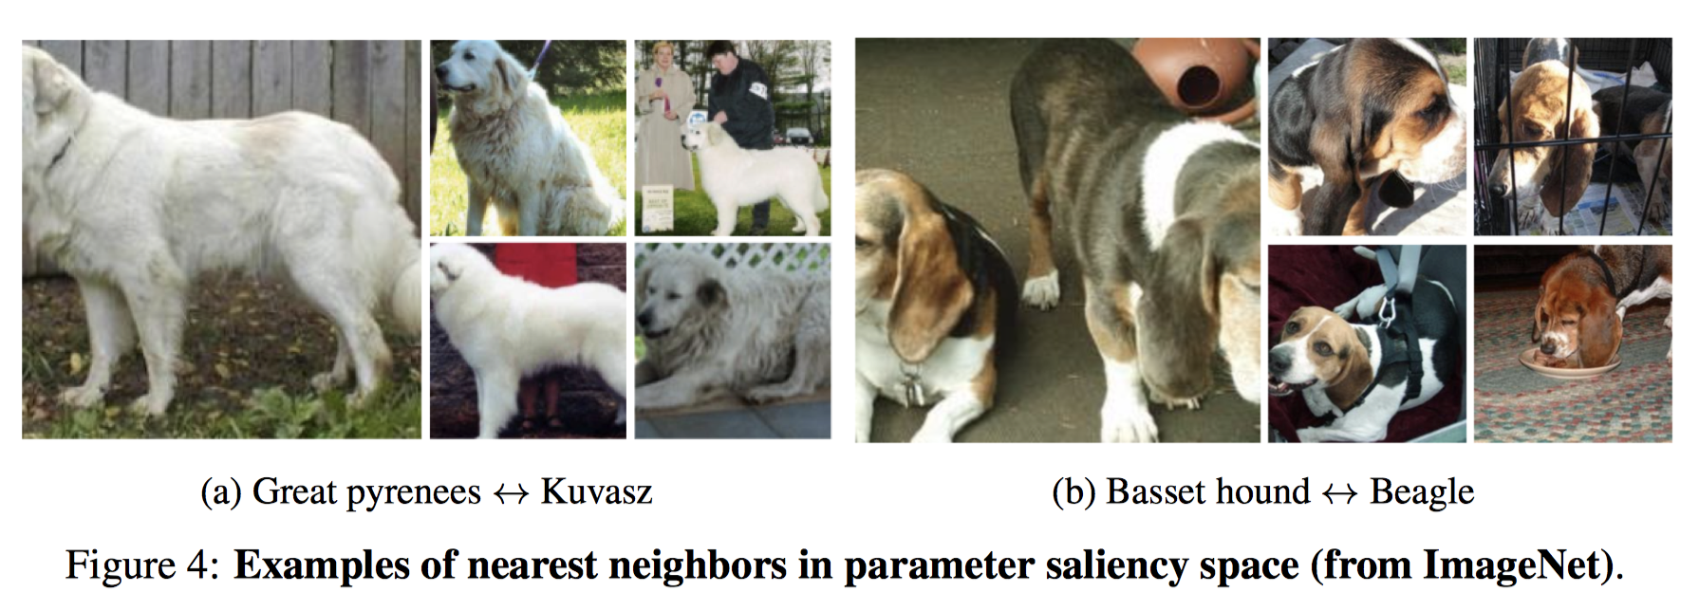
Nearest Neighbors in Parameter Saliency space
cluster images based on the cosine similarity of their profiles.

Slide 17
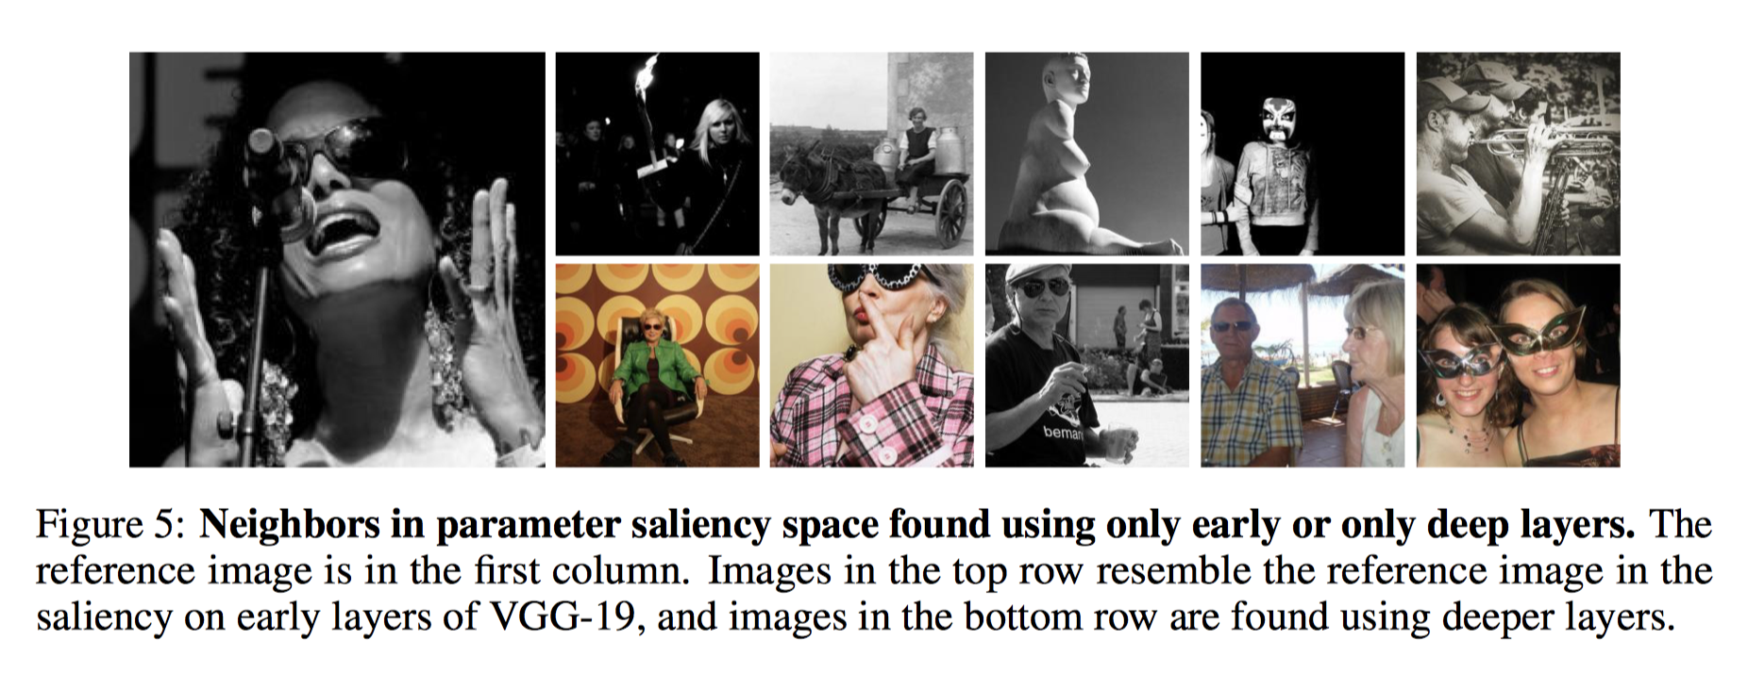
Nearest neighbors using early and deeper layers
Notes:
The top row images share basic image attributes such as color, histogram. (found based on early layer filters)
The bottom row images share more abstract similarities.

Slide 18
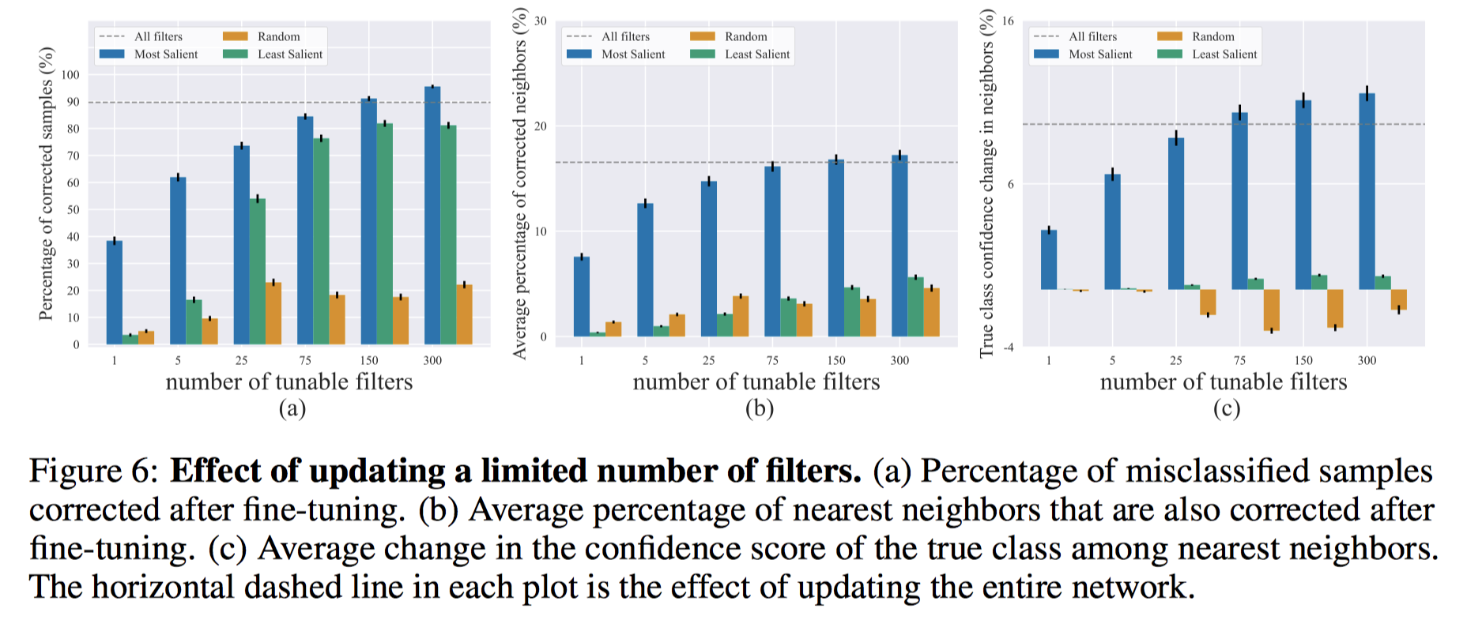
Fine-tuning to correct mistakes
Fine-tune a pretrained ResNet-50 for one step on a single image
Track the model’s performance on the image’s nearest neighbors
No label information of nearest neighbors used.
tunable filters to be no more than 1.0%
Notes:
We evaluate the effect of fine-tuning on each of these images (ImgNet val set) independently and find the corresponding nearest neighbors from a holdout ImageNet-v2 test set where we limit the search scope exclusively to misclassified images too.
Panel a: we see that updating 150 most salient filters (∼0.6% of total filters) is enough to achieve the same percentage of corrections as updating the entire network.
Panel b and c: track model predictions and true class confidence scores among the 10 nearest neighbors of each sample. The nearest neighbors found using our method are the images that are wrong for similar reasons and that they can be corrected altogether by only updating the salient filters on a single image.

Slide 19
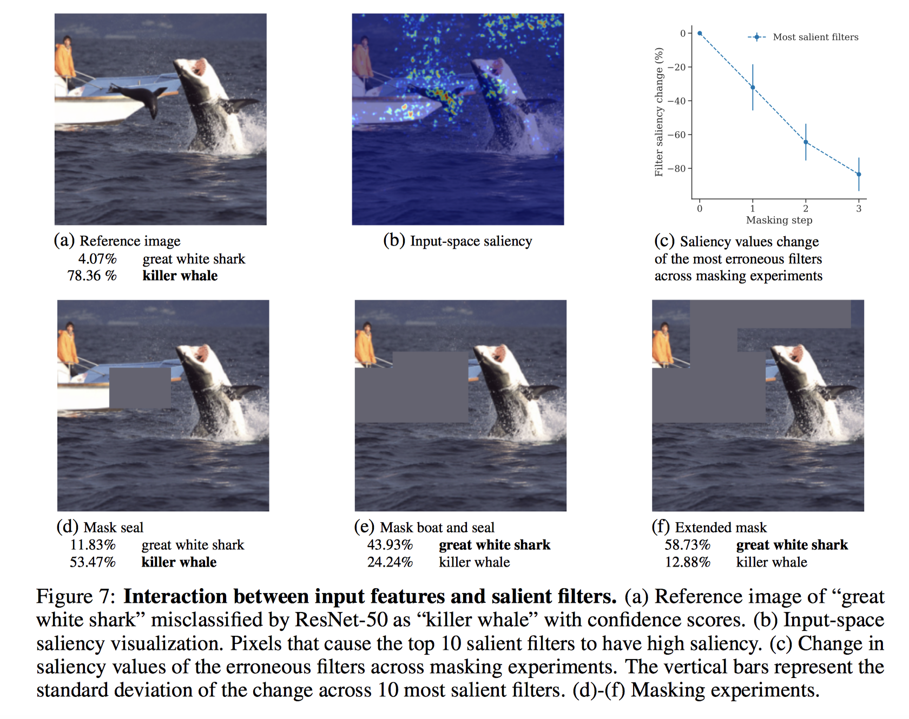
Interpretable Network Failures
Notes:
Visualizing Input Features Which Trigger Filter Malfunctions
Panel b: identify filters (10) most responsible for misclassification and visualize parts of the image that drive the high saliency values for those filters.
we pasted it from this image onto other great white shark images (see Appendix A) and observed that this drives the probability of “killer whale” up for 39 out of 40 examples of great white sharks from the ImageNet validation set
Possible reasons for the erroneous behavior of the model: a) a non-target object in the image. b) spurious correlations made out of background structures or other objects as found from the training examples in the dataset.

Slide 20
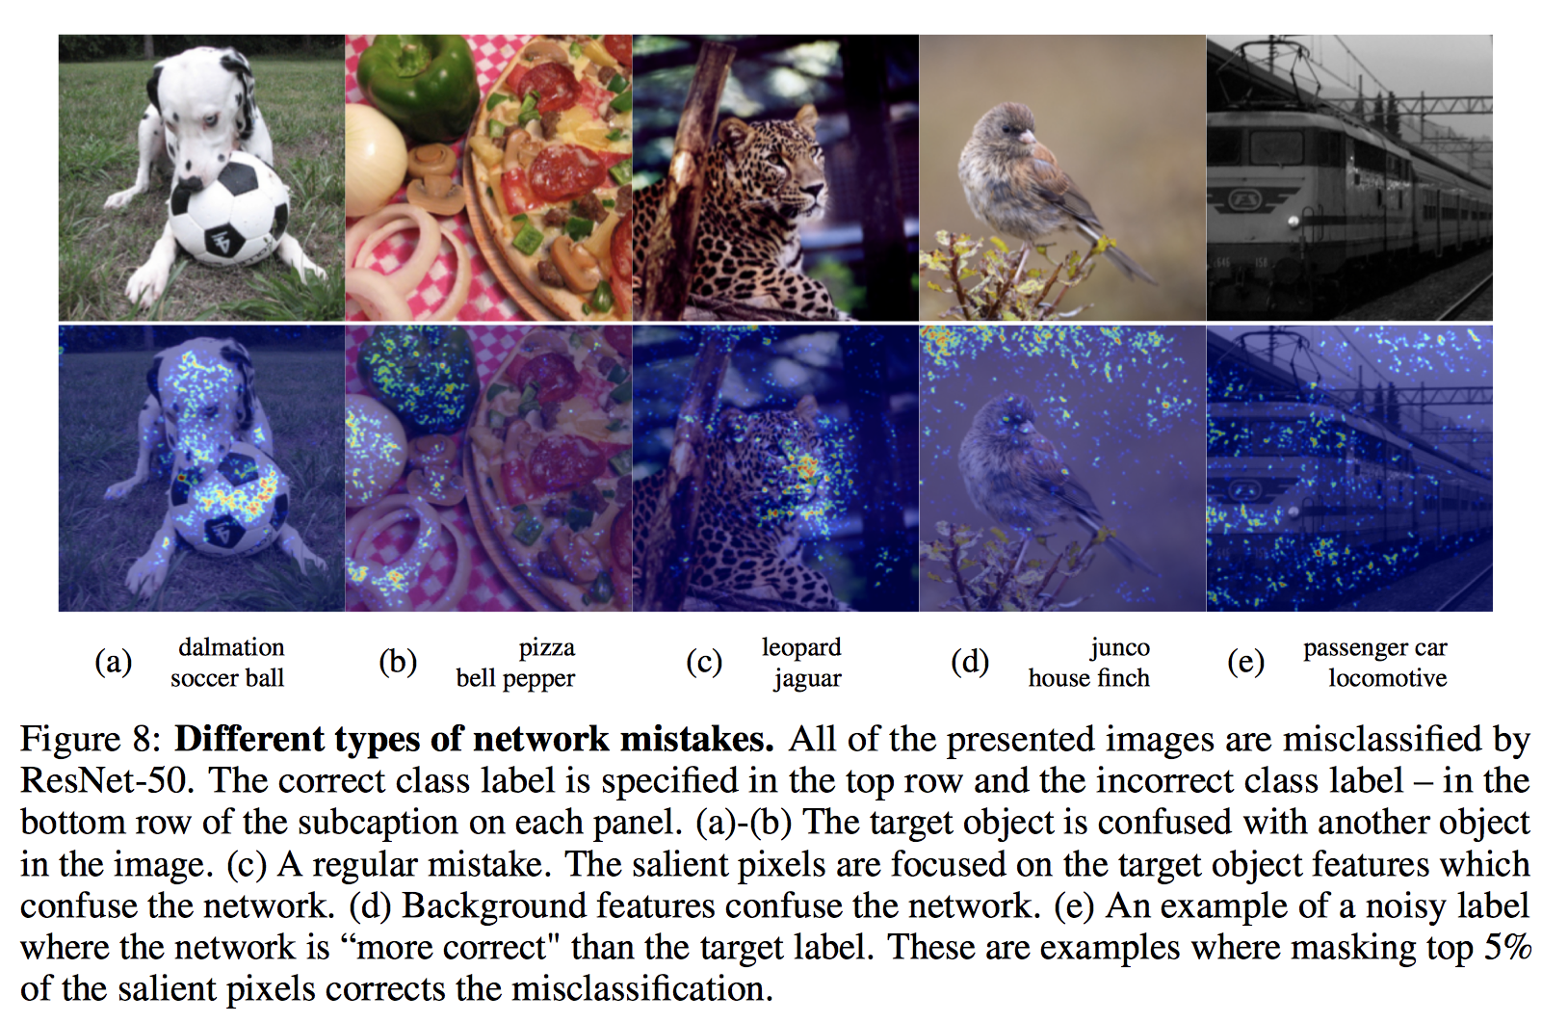

Slide 21
Conclusion
Input-space saliency identifies the regions in the input for which model is doing well.
Parameter-space saliency identifies the parameters in the model-space where model is doing wrong.
When these two saliencies are coordinated well, the semantics for which the model is making error can be identified and the corresponding parameters can be detected.
identified salient parameters are responsible for misclassification but they are not the only responsible params in the space.
Notes:
This framework is for finding the exact filters which are responsible for faulty predictions and studying the interactions between these filters and images. This direction yields an interpretable understanding of model behaviors.

Slide 22
Thank you! Contact: mrahman21@gsu.edu
Notes:
Thanks for your patience. At this point, I would like to take any questions you may have in your mind.

